Slide 1
7
Pointers
Objectives
In this chapter, you’ll:
Use pointers and pointer operators.
Pass arguments to functions by reference using pointers.
Understand the const qualifier’s various placements and how they affect what operations you can perform on a variable.
Use the sizeof operator with variables and types.
Use pointer arithmetic to process array elements.
Understand the close relationships among pointers, arrays and strings.
Define and use arrays of strings.
Use function pointers.
Learn about secure C programming with pointers.

Slide 2
7.1 Introduction
In this chapter, we discuss one of C’s most powerful features—the pointer. Pointers enable programs to
accomplish pass-by-reference,
pass functions between functions,
manipulate strings and arrays, and
create and manipulate dynamic data structures that grow and shrink at execution time, such as linked lists, queues, stacks and trees.

Slide 3

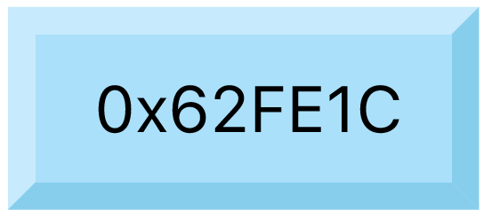
Concept
a
int a=10;
location
0x62FE1C
printf(“%p”, &a);
int *aPtr;
aPtr = &a;
printf(“%p”, aPtr);
printf(“%d”, *aPtr);
*
// 0x62FE1C
aPtr
// aPtr=0x62FE1C
// 0x62FE1C
// 10

Slide 4
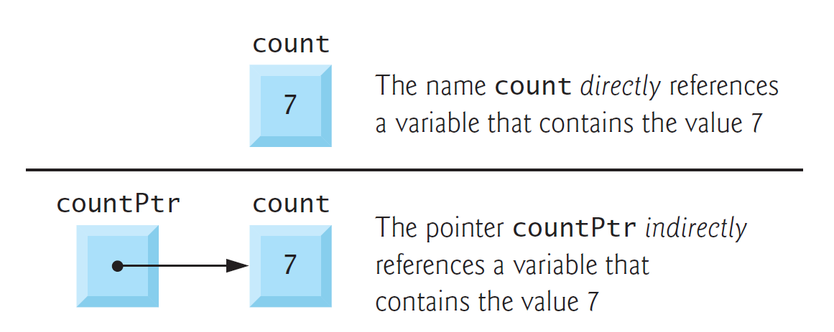
7.2 Pointer Variable Definitions and Initialization
Pointers are variables whose values are memory addresses. Usually, a variable directly contains a specific value. A pointer, however, contains the address of another variable that contains a specific value. The pointer points to that variable. In this sense, a variable name directly references a value, and a pointer indirectly references a value, as in the following diagram:

Slide 5
7.2 Pointer Variable Definitions and Initialization
Pointers are variables whose values are memory addresses. Usually, a variable directly contains a specific value. A pointer, however, contains the address of another variable that contains a specific value. The pointer points to that variable. In this sense, a variable name directly references a value, and a pointer indirectly references a value, as in the following diagram:

Slide 6
7.2 Pointer Variable Definitions and Initialization
Pointers are variables whose values are memory addresses. Usually, a variable directly contains a specific value. A pointer, however, contains the address of another variable that contains a specific value. The pointer points to that variable. In this sense, a variable name directly references a value, and a pointer indirectly references a value, as in the following diagram:

Slide 7
7.2 Pointer Variable Definitions and Initialization
Pointers are variables whose values are memory addresses. Usually, a variable directly contains a specific value. A pointer, however, contains the address of another variable that contains a specific value. The pointer points to that variable. In this sense, a variable name directly references a value, and a pointer indirectly references a value, as in the following diagram:

Slide 8
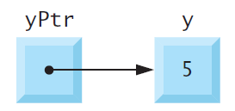
7.3 Pointer Operators
The Address (&) Operator
The unary address operator (&) returns the address of its operand. For example, given the following definition of y:
int y = 5;
the statement
int *yPtr = &y;
initializes pointer variable yPtr with variable y’s address—yPtr is then said to “point
to” y. The following diagram shows the variables yPtr and y in memory:

Slide 9
7.3 Pointer Operators
Indirection (*) Operator
You apply the unary indirection operator (*), also called the dereferencing operator, to a pointer operand to get the value of the object to which the pointer points. For example, the following statement prints 5, which is the value of variable y:
printf("%d", *yPtr);
Using * in this manner is called dereferencing a pointer.

Slide 10
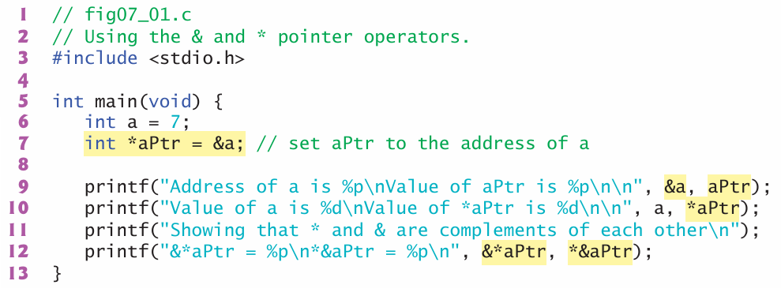
7.3 Pointer Operators
Demonstrating the & and * Operators

Slide 11
7.3 Pointer Operators
Demonstrating the & and * Operators

Slide 12
7.3 Pointer Operators
Demonstrating the & and * Operators

Slide 13
7.3 Pointer Operators
Demonstrating the & and * Operators

Slide 14
7.3 Pointer Operators
Demonstrating the & and * Operators

Slide 15
7.3 Pointer Operators
Demonstrating the & and * Operators

Slide 16
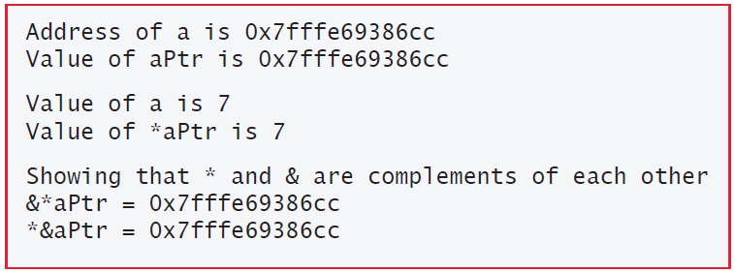
7.3 Pointer Operators
Demonstrating the & and * Operators

Slide 17
7.4 Passing Arguments to Functions by Reference
There are two ways to pass arguments to a function—pass-by-value and pass-by-reference.
By default, arguments (other than arrays) are passed by value. As you’ve seen, arrays are passed by reference.
Pass-by-reference also can enable a function to “return” multiple values by modifying the caller’s variables.

Slide 18
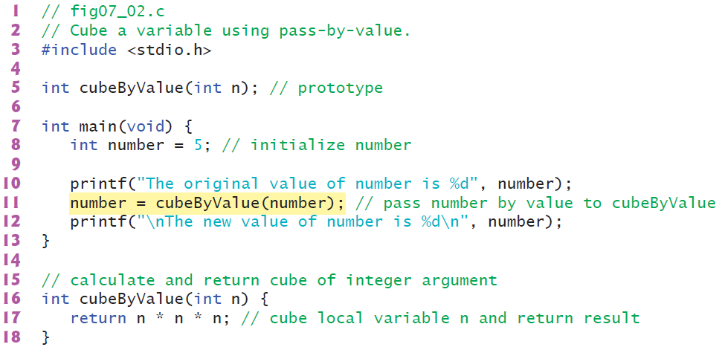
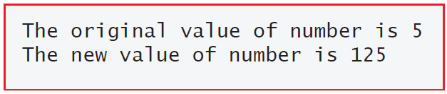
7.4 Passing Arguments to Functions by Reference
Pass-By-Value

Slide 19
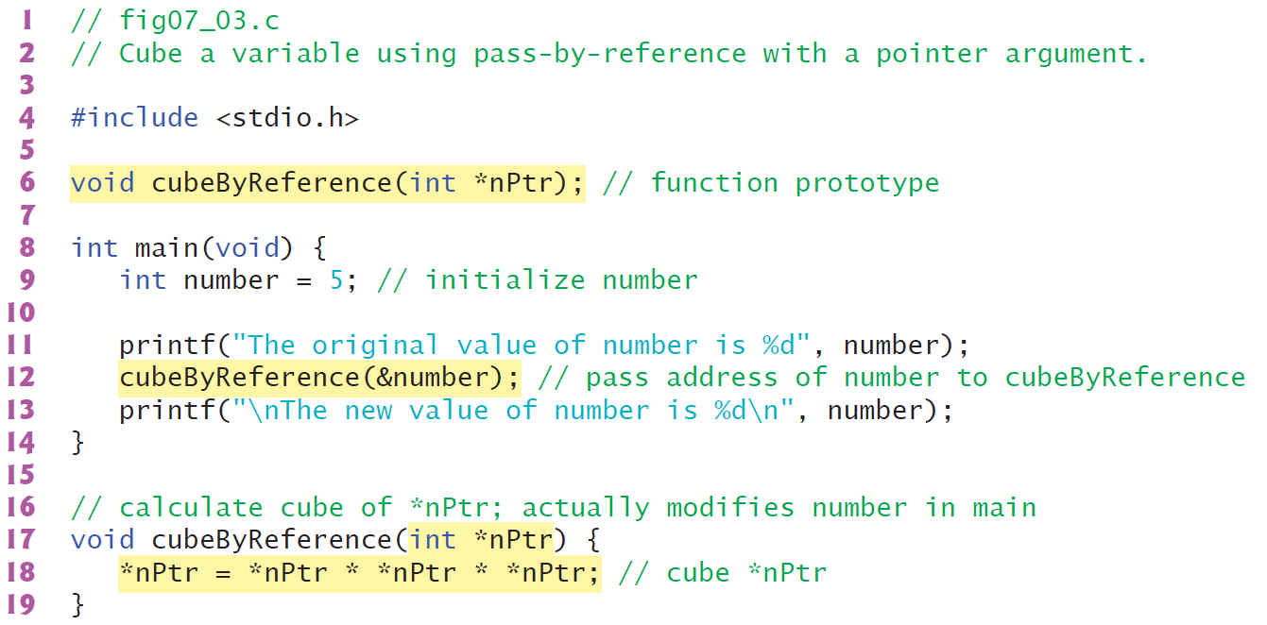
7.4 Passing Arguments to Functions by Reference
Pass-By-Reference

Slide 20
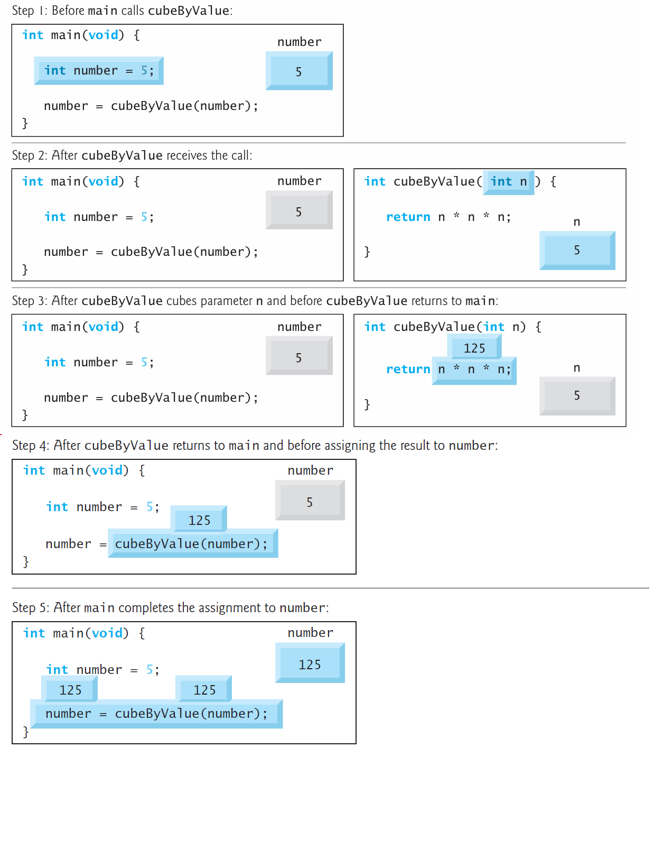
7.4 Passing Arguments to Functions by Reference
Pass-By-Value vs. Pass-By-Reference Step-By-Step

Slide 21
7.4 Passing Arguments to Functions by Reference
Pass-By-Value vs. Pass-By-Reference Step-By-Step

Slide 22
7.4 Passing Arguments to Functions by Reference
Pass-By-Value vs. Pass-By-Reference Step-By-Step

Slide 23
7.4 Passing Arguments to Functions by Reference
Pass-By-Value vs. Pass-By-Reference Step-By-Step

Slide 24
7.4 Passing Arguments to Functions by Reference
Pass-By-Value vs. Pass-By-Reference Step-By-Step

Slide 25
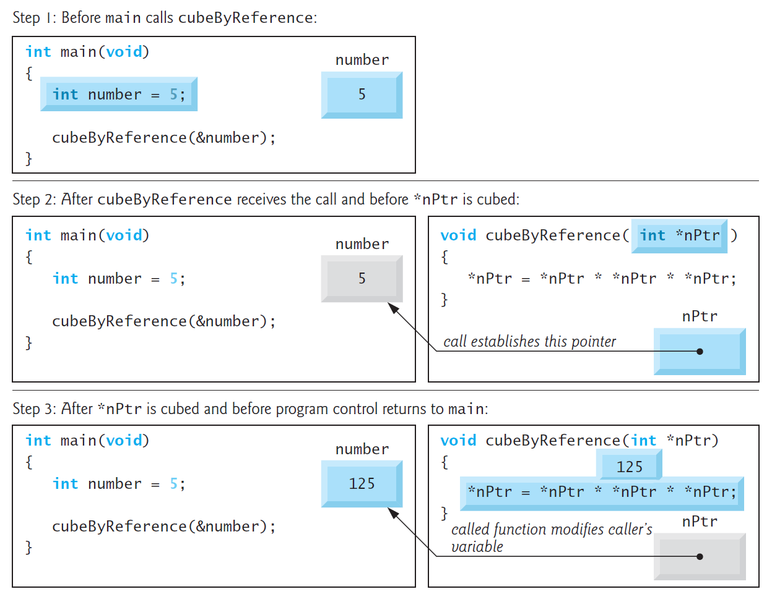
7.4 Passing Arguments to Functions by Reference
Pass-By-Value vs. Pass-By-Reference Step-By-Step

Slide 26
7.4 Passing Arguments to Functions by Reference
Pass-By-Value vs. Pass-By-Reference Step-By-Step

Slide 27
7.4 Passing Arguments to Functions by Reference
Pass-By-Value vs. Pass-By-Reference Step-By-Step

